Slide 1
USABILITY OF BITCOINS
Overview
Pros And Cons
Current Situation
The Future
Growth
Some Interesting Cases

Slide 2
Notes:
https://medium.com/@octskyward/the-resolution-of-the-bitcoin-experiment-dabb30201f7#.ebwc7550h

Slide 3
Current Situation
“One of the great things about Bitcoin is its lack of democracy”
The growth of bitcoin usage in the last 5 years has been exponential and there have been numerous theories and beliefs regarding this crypto-currency's future. Bitcoins have proved to be a suitable alternative to existing financial systems where people from all across the world have adopted this new currency and have already made millions out of it.
The supply Growth of Bitcoins has been set to be 25 bitcoins per block until mid 2016 and is believed to half down to 12.5 for the next 4 years before it halves again. This process is believed to continue until 2110 to 2140 by when all the 21million bitcoins available would have been used.

Slide 4
To Start With..
The first Bitcoin Transaction was made on the 12th Jan 2009 from Satoshi to Hal Finney.
To get a glimpse of the growth of Bitcoins we might start with the fact that it started as:
$1 = 1,309.03 BTC
And now it is:
$416 = 1 BTC
As the stats portray, the growth of Bitcoins has been massive and it has made a huge impact on various financial systems all across the globe.
The usability of Bitcoins increased gradually with the passing years and by the end of 2011, people had started buying things as expensive as a vehicle using this innovative pseudo-currency.
By 2016, Bitcoin has passed numerous milestones which clearly highlight how widely the concept has been accepted and where its heading towards.

Slide 6
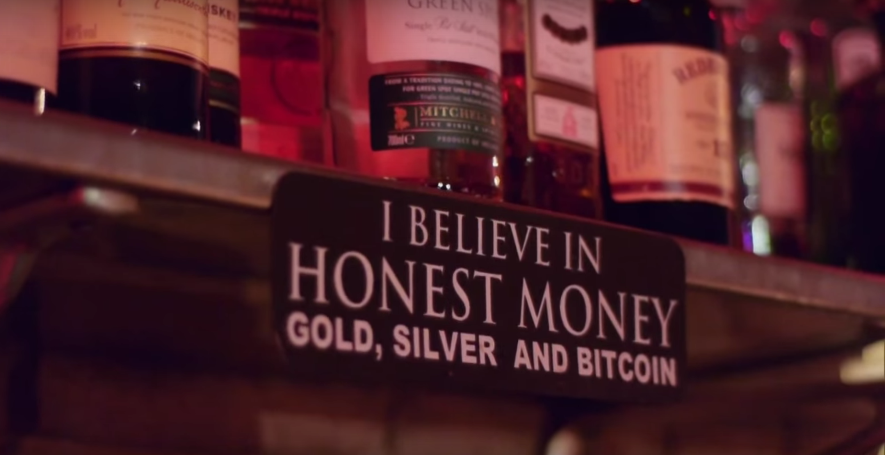

The Evolution of Bitcoin, from Behind a Berlin Bar
Nowadays, spending your bitcoins is not a problem anymore. You can eat, drink, buy a car or even a house with the crypted virtual currency. But the situation was a lot different 5 years ago when you had to fly to Berlin and make your way to a small bar in the city’s Kreuzberg district if you wanted to spend bitcoins. Room 77 in the German capital is reveling 5 years of accepting the crypto-currency. The owner of the bar, Joerg Plazter, claims that it was around May 2011 when he accepted the first Bitcoin transaction for a beer. This transaction is believed to be the world’s first purchase with digital currency in a shop, restaurant or bar.
A sign board from Room 77, Berlin. 2013
Joerg Plazter – Owner Room 77
Nov 2013
Notes:
http://www.coindesk.com/evolution-bitcoin-behind-berlin-bar/

Slide 7
Then and Now
The usability of bitcoins has amplified since its beginning. It has seen some highs and lows, it has been embraced by many and disgraced by the rest but it still continues its march towards global recognition. Back then, Platzer explained, he was happy if he had one or two bitcoin purchases per month; now he has up to 10 purchases per evening.
Back then people would turn up with their laptops and manually type in the address codes to make transactions; now young hipsters show up with their smartphones and make transactions like it’s the easiest thing in the world.
Back then Platzer would be ecstatic if four people showed up to a bitcoin meetup; now his bar fills up on the first Thursday of every month when the local enthusiasts meet.
Platzer described himself as an old-school “hacker, lock picker and phreak”. In his circles there was talk of a decentralized digital currency for years, and when he heard about bitcoin for the first time he knew he was on to something big.

Slide 8
“Everyone was laughing about it and people were asking 'what is this funny bitcoin stuff [that] was on the wall'. The staff just shook their heads and said it was some strange thing the boss liked.”

Slide 9
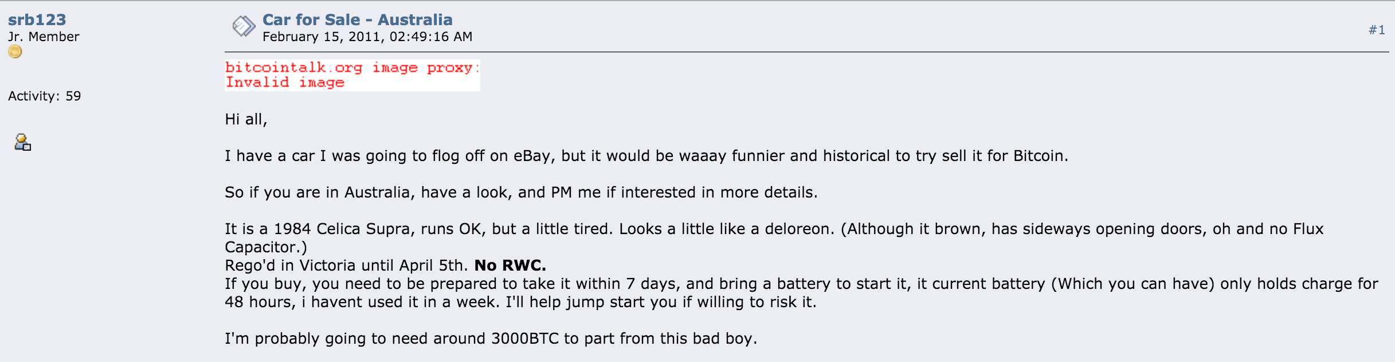
Milestones..
August 18 2008 | Domain name "bitcoin.org" registered
Feb 14 2011
An Australian member of the Bitcoin Forum attempts to sell his 1984 Celica Supra for 3000 BTC, and becomes the first person to offer a vehicle in exchange for Bitcoins.
The advert for the first car sold via a Bitcoin transaction
Notes:
https://bitcointalk.org/index.php?topic=3485.0

Slide 10
194,993 BTC transaction worth $147 Million sparks mystery and speculation
The transaction, tagged "Shit Load of Money!" by its mystery originator, appeared on Blockchain.info early in the evening of 22nd November. It is one of the largest transactions in bitcoin's history, by far the largest under bitcoin's recent high prices, and represented 1.6% of all bitcoins in circulation at that time.
Nov 22 2013
Linode hacked, 46,000 BTC stolen
A security breach at Linode, a website hosting company, results in the largest theft of Bitcoins recorded to date. More than 46,000 BTC are stolen, valued at over US$228,000.
March 2012

Slide 11
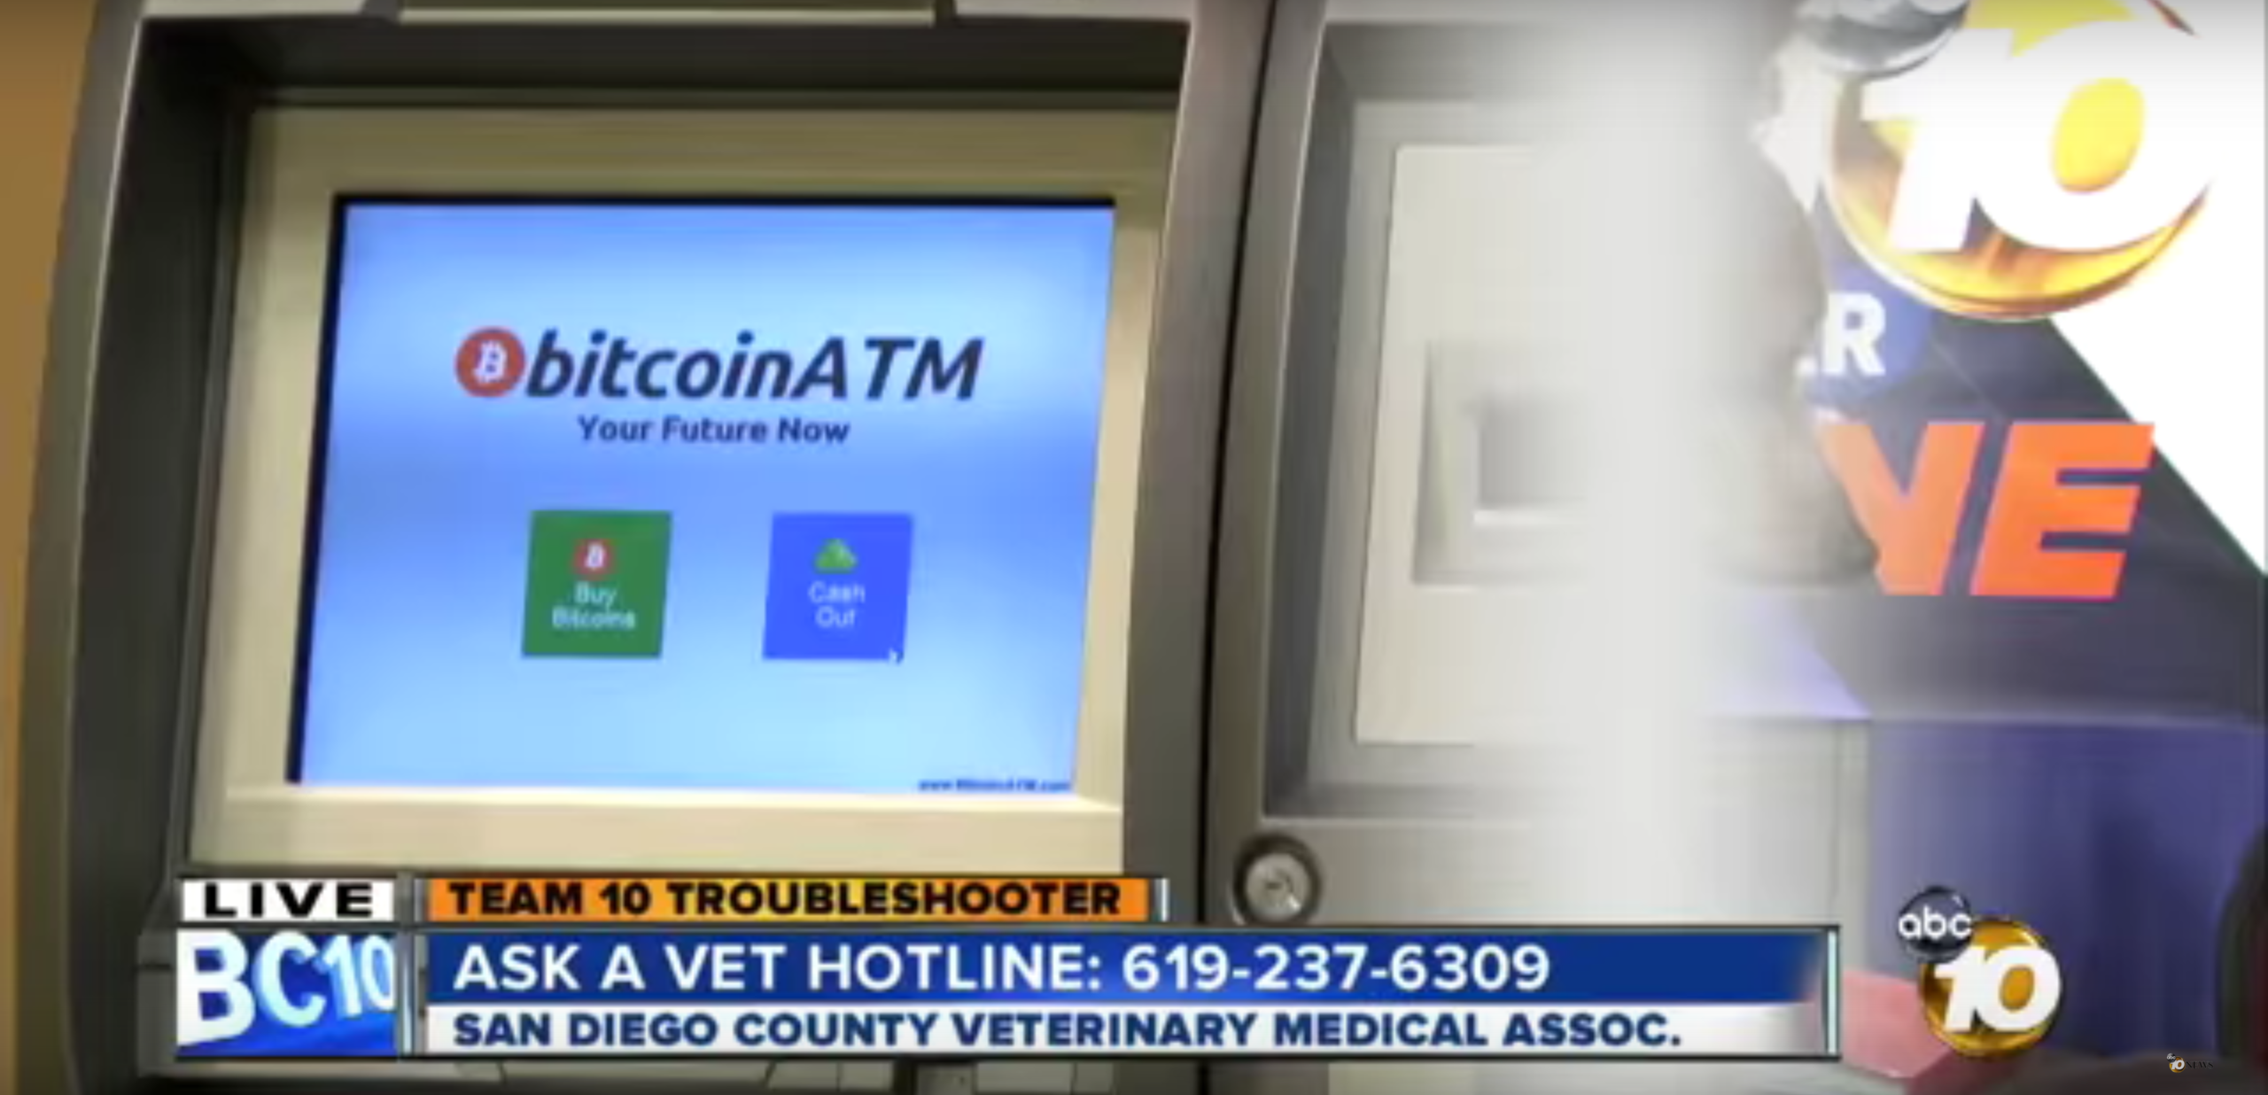
Market cap reaches $1 billion
The total Bitcoin market cap passes US$1 billion.
March 28 2013
First Bitcoin ATM unveiled
The first Bitcoin ATM in the world is debuted in San Diego, California.
May 2 2013

Slide 12
Bitcoin sets new all-time high
The price of the Bitcoin breaks record set in April 2013, despite the Silk Road bust and fears over security, reaching US$269 per bitcoin.
November 6, 2013

Slide 13
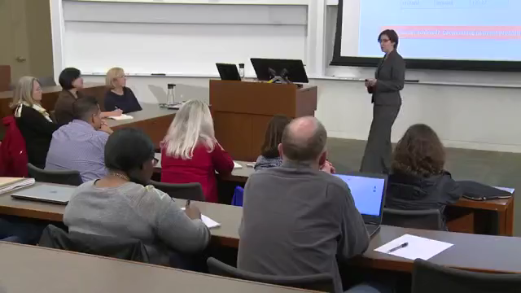
Overview

Slide 14
Pros And Cons
Advantages
Freedom In Payment
With bitcoins you are very much likely to send and receive money from anywhere in the entire world at any given time.
Bitcoin has no government tied to it and stays independent from any financial system that exists in the world.
Information is Transparent
With the block chain, all finalized transactions are available for everyone to see, however personal information is hidden.
Your public address is what is visible; however, your personal information is not tied to this.
Anyone at anytime can verify transactions in the Bitcoin block chain.
Bitcoin protocol cannot be manipulated by any person, organization, or government. This is due to Bitcoin being cryptographically secure.
Trade with Absolute Confidence
Unlike trading on exchanges, speculating on the bitcoin price is 100% secure from theft.
The whole Bitcoin network is a communal one, and as such, is synchronized and secured by thousands of non-partisan computers. Fraud drops almost entirely out of the picture. As for cryptography of personal information, Bitcoin is still an astronomically secure system.
Innovative and Trendy
As we know, the concept was introduced in by an anonymous Japanese who believed :
“Yes, [we will not find a solution to political problems in cryptography,] but we can win a major battle in the arms race and gain a new territory of freedom for several years.” –Satoshi Nakamoto

Slide 15
Disadvantages
Risk and Volatility
The number of Bitcoins is fixed and cant be changed while its demand increases with every passing year. This will ultimately lead to an inevitable end. Moreover, Bitcoin’s prices bounces daily mainly because of the various current events related to digital currency.
“That bitcoin you just spent for a pizza could have been a pizza franchise if you’d waited till tomorrow.”
-Erik Robie(Blogger)
Still Developing
Although it has been 5 years since its invention, Bitcoin is still at its initial phases with incomplete features that are in development.
According to some predictions, Bitcoins has some growth to do before it comes to its complete capacity and usage.
Inevitable Opposition
A higher use of Bitcoin is a huge threat to Financial Systems, Governments and private sector businesses all across the world. This eventually leads to a lot of opposition and conspiracies against this virtual currency. The situation has gone to worse from 2012 when it all started where Bitcoins had to sustain tremendous pressure and rebellion.

Slide 16
Bitcoins are favorite of Criminals
Bitcoins have become “the currency of choice for people online buying drugs or other illicit activities.”
Bitcoins have been used by terrorist organizations and by illegal online websites as their mean of transactions. Terrorists need anonymity and they have always looked for new ways to do it, and it appears they have found it in Botcoins.

Slide 17
Bitcoin is a digital global commodity, being used as a bartering medium.

